Slide 1
A comparative analysis of discrete choice models estimations, using different software packages
Semester project, Final Presentation
Alexia Paratte
Supervised by Evangelos Paschalidis, Negar Rezvany and Michel Bierlaire

Slide 2
Outline
Project Description
Recap of midterm Presentation
Swissmetro
Future goals

Slide 3
Project Description
Motivation and Process

Slide 4
Motivation
Discrete choice models widely used: transportation, environment, economics, marketing
Many software to estimate these models, such as Biogeme (Python) and Apollo (RStudio)
Goal: Comparing Biogeme and Apollo -> performances, results, available features
Different kind of models
Notes:
Avoid long text, be precise (more bulletpoint, less words)

Slide 5
Process
Example scripts from the Apollo website and translate them to Biogeme
Make sure the models are equivalent: toml file, panel data, FLL, etc
Compare the estimation times for both software
Compare CPU/RAM usage

Slide 6
Recap: Midterm Presentation
MNL Revealed Preferences model
MMNL Preference model

Slide 7
Model and data description
Most basic MNL (Multinomial Logit Model) on Apollo website, revealed preferences, called RP_Model
Synthetic dataset apollo_modeChoiceData looking at mode choice for 500 travelers.
Choices are either car, bus, air or rail
Parameters (9 to be estimated): travel time, travel cost, access (except for car)
Availabilities

Slide 8
Swissmetro
MMNL Model
1 random coefficient

Slide 9
Model and data description
MMNL Model called swissmetro
biogeme_swissmetro, data collected on trains between St. Gallen and Geneva,Switzerland, in March 1998 (Axhausen et al. (2001))
441 individuals, 9 stated choice situation, 3 alternatives: rail, Swissmetro, car
Panel data (added to the original script)
Availabilities
Halton Draws, Monte-Carlo Estimation
Biogeme: Newton w/ simple bounds → BFGS w/ simple bounds
Apollo: BGW → BFGS
Second derivative 0

Slide 10
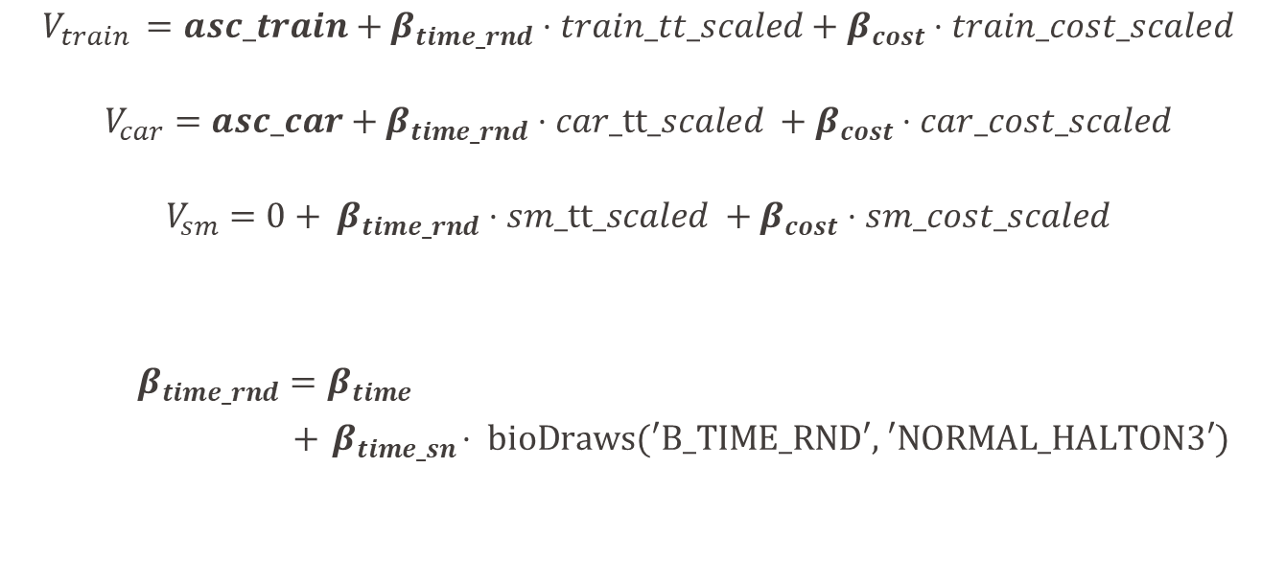
Utilities
$$V_{train }=asc_train+β_{time_rnd}⋅train_tt_scaled+β_{cost}⋅train_cost_scaled$$
$$V_{car}=asc_car+β_{time_rnd}⋅car_tt_scaled +β_{cost}⋅car_cost_scaled$$
$$V_{sm}=0+ β_{time_rnd}⋅sm_tt_scaled +β_{cost}⋅sm_cost_scaled$$
$β_{time_rnd}=β_{time}$
$+{ β}_{time_sn}⋅ \text{bioDraws}\text{(′}\text{B}\text{_}\text{TIME}\text{_}\text{RND}\text{′, ′}\text{NORMAL}\text{_}\text{HALTON}\text{3′)}$
Notes:
Instead of assuming fixed effect for travel time, i.e. assuming that βtime rnd is constant across
all individuals, the model allows for the possibility that different individuals have different
sensitivities or preferences travel time. This reflects the heterogeneity in preferences or behaviors
across the sample

Slide 11
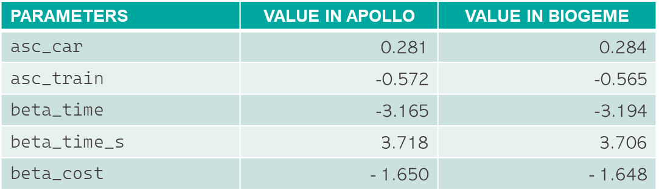
Estimation and statistics (100 draws)
PARAMETERS | VALUE IN APOLLO | VALUE IN BIOGEME
asc_car | 0.281 | 0.284
$$\text{asc}\text{_}\text{train}$$ | -0.572 | -0.565
$$\text{beta}\text{_}\text{time}$$ | -3.165 | -3.194
beta_time_s | 3.718 | 3.706
beta_cost | - 1.650 | - 1.648
 | VALUE IN APOLLO | VALUE IN BIOGEME
Initial Loglikelihood | - 5’782.84 | -5’784.81
Final Loglikelihood | - 4’363.05 | - 4’362.97
Notes:
Not sure whether this is relevant, maybe just say got same results in both Apollo/Biogeme go through the slide quickly)

Slide 12
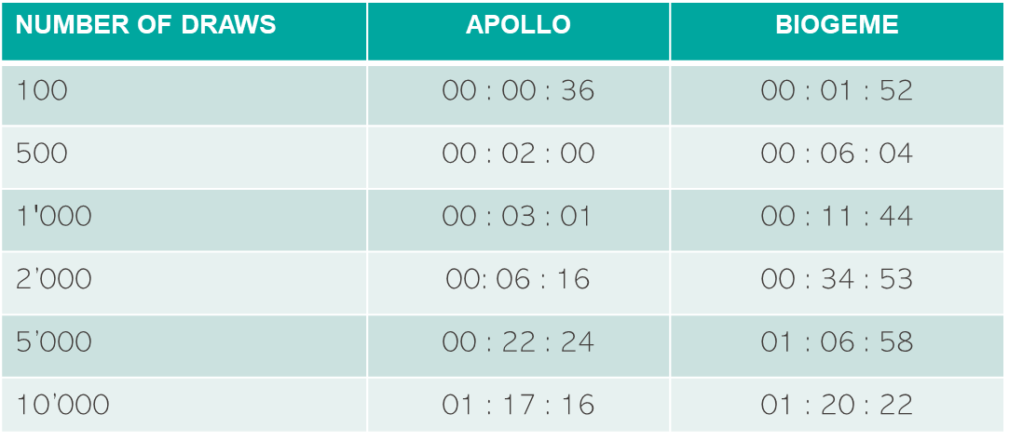
Estimation times
NUMBER OF DRAWS | APOLLO | BIOGEME
100 | 00 : 00 : 36 | 00 : 01 : 52
$$\text{500}$$ | 00 : 02 : 00 | 00 : 06 : 04
$$\text{1′000}$$ | 00 : 03 : 01 | 00 : 11 : 44
2’000 | 00: 06 : 16 | 00 : 34 : 53
5’000 | 00 : 22 : 24 | 01 : 06 : 58
10’000 | 01 : 17 : 16 | 01 : 20 : 22
Notes:
Not sure whether this is relevant, maybe just say got same results in both Apollo/Biogeme go through the slide quickly)

Slide 13
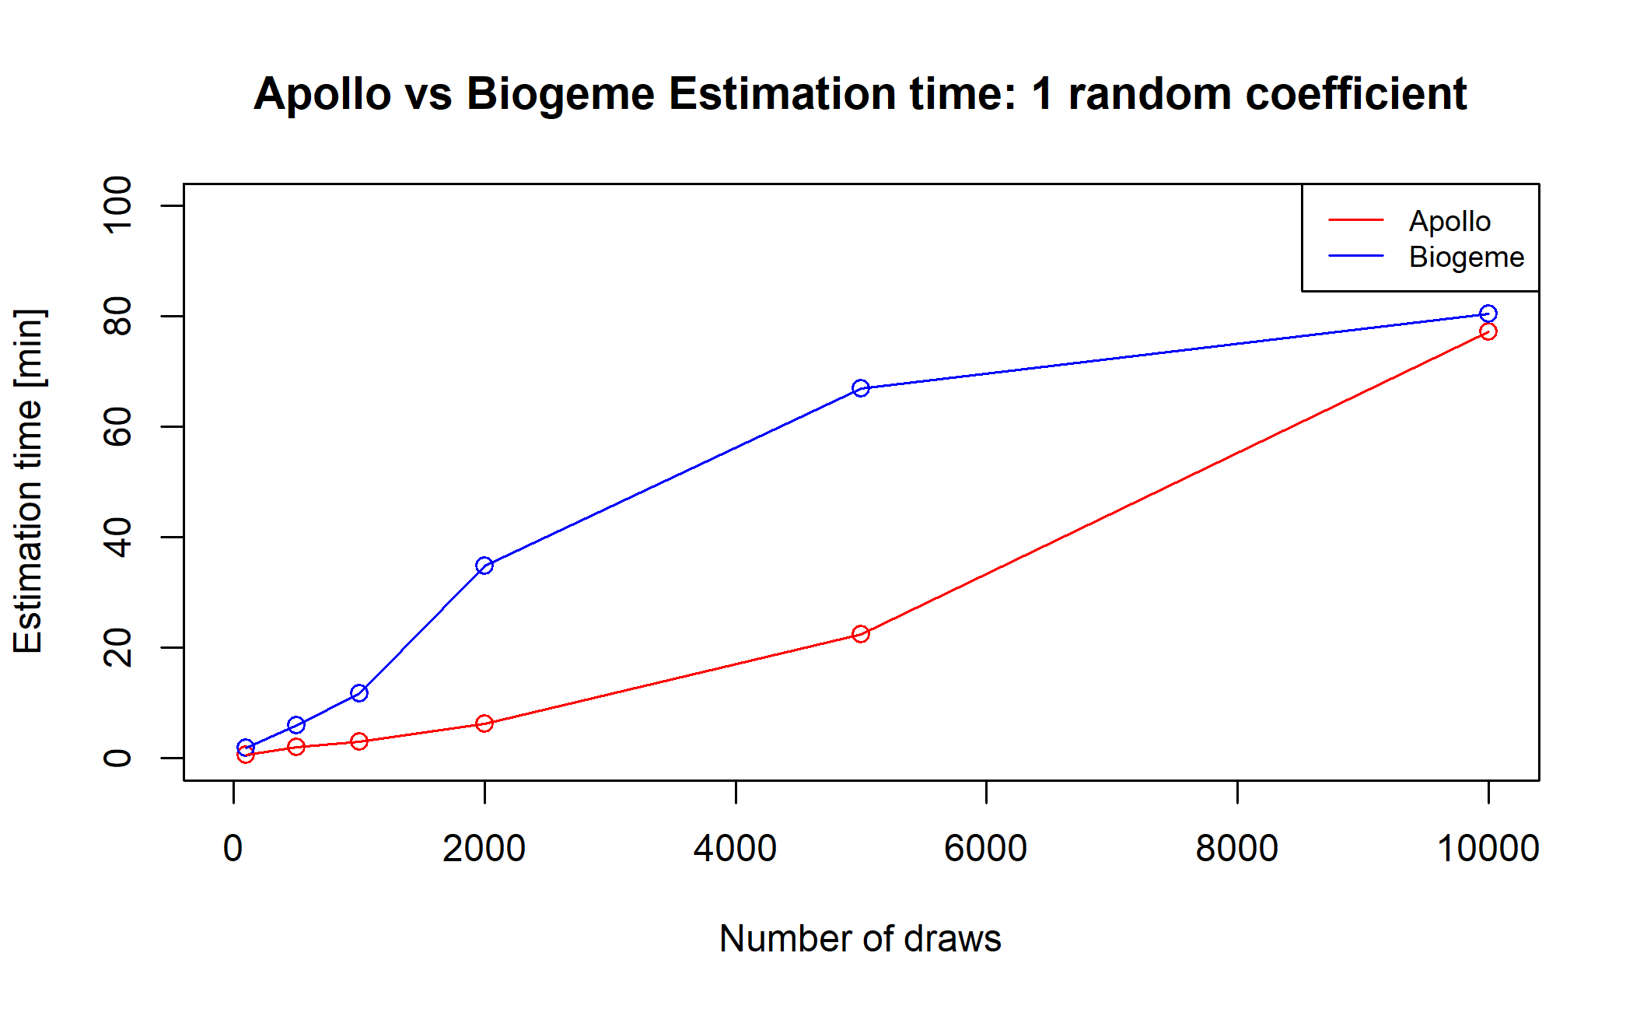
Draws Plot

Slide 14
Swissmetro 2
MMNL Model
4 random coefficients

Slide 15
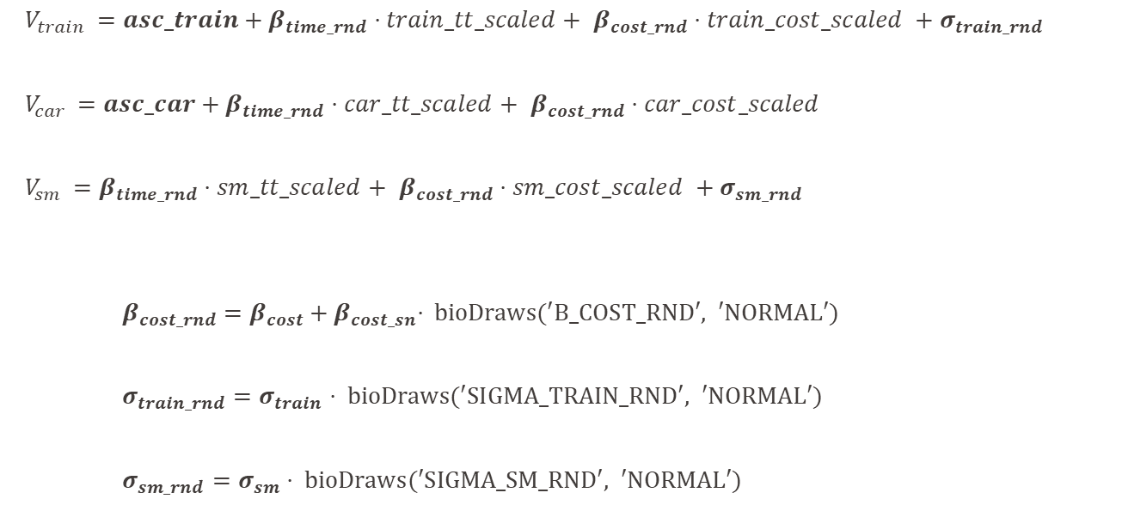
Utilities
$V_{train }=asc_train+β_{time_rnd}⋅train_tt_scaled+$ $β_{cost_rnd}⋅train_cost_scaled +σ_{train_rnd}$
$V_{car }=asc_car+β_{time_rnd}⋅car_tt_scaled+$ $β_{cost_rnd}⋅car_cost_scaled$
$V_{sm }=β_{time_rnd}⋅sm_tt_scaled+$ $β_{cost_rnd}⋅sm_cost_scaled +σ_{sm_rnd}$
$β_{cost_rnd}=β_{cost}+{ β}_{cost_sn}⋅ \text{bioDraws}\text{(′}\text{B}\text{_}\text{COST}\text{_}\text{RND}\text{′, ′}\text{NORMAL}\text{′)}$
$σ_{train_rnd}=σ_{train}⋅ \text{bioDraws}\text{(′}\text{SIGMA}\text{_}\text{TRAIN}\text{_}\text{RND}\text{′, ′}\text{NORMAL}\text{′)}$
$σ_{sm_rnd}=σ_{sm}⋅ \text{bioDraws}\text{(′}\text{SIGMA}\text{_}\text{SM}\text{_}\text{RND}\text{′, ′}\text{NORMAL}\text{′)}$
Notes:
Instead of assuming fixed effect for travel time, i.e. assuming that βtime rnd is constant across
all individuals, the model allows for the possibility that different individuals have different
sensitivities or preferences travel time. This reflects the heterogeneity in preferences or behaviors
across the sample

Slide 16
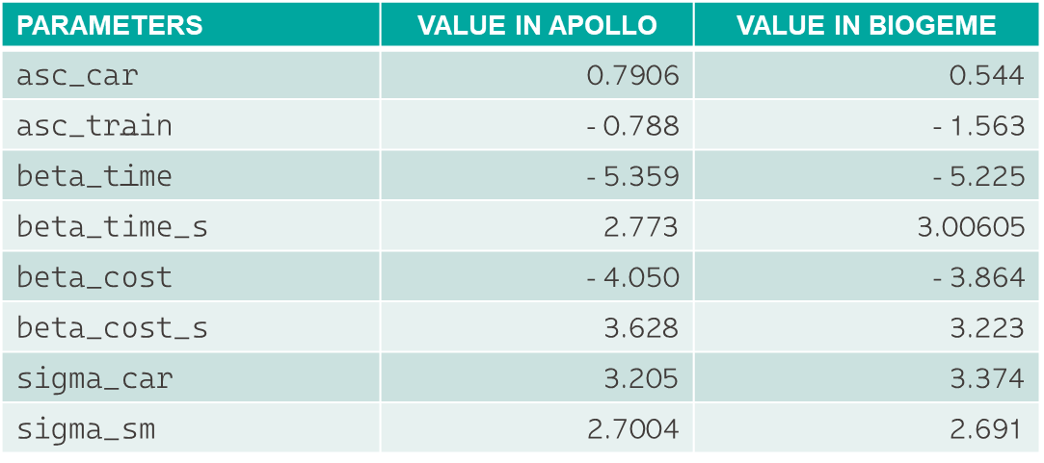
Estimation and statistics (100 draws)
PARAMETERS | VALUE IN APOLLO | VALUE IN BIOGEME
asc_car | 0.7906 | 0.544
$$\text{asc}\text{_}\text{train}$$ | - 0.788 | - 1.563
$$\text{beta}\text{_}\text{time}$$ | - 5.359 | - 5.225
beta_time_s | 2.773 | 3.00605
beta_cost | - 4.050 | - 3.864
beta_cost_s | 3.628 | 3.223
sigma_car | 3.205 | 3.374
sigma_sm | 2.7004 | 2.691
 | VALUE IN APOLLO | VALUE IN BIOGEME
Initial Loglikelihood | - 4’851.99 | - 3’622.264
Final Loglikelihood | -3’603.42 | - 3’603.30
Notes:
Not sure whether this is relevant, maybe just say got same results in both Apollo/Biogeme go through the slide quickly)

Slide 17
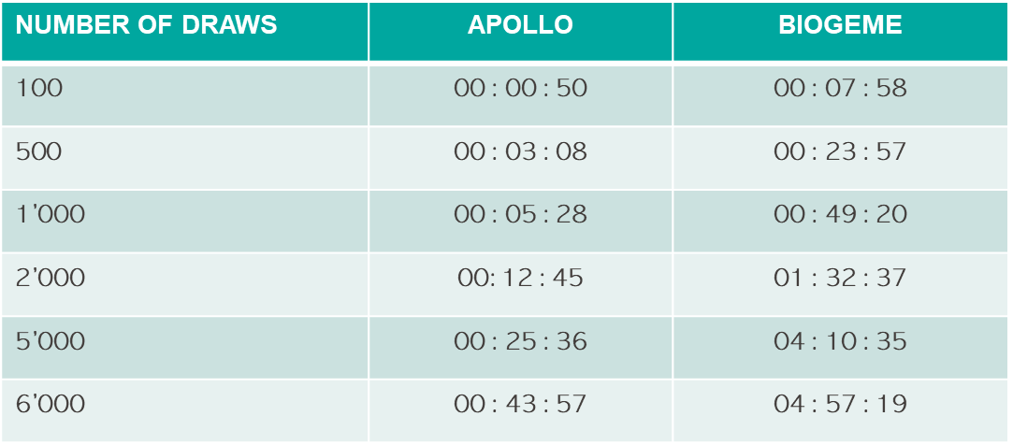
Estimation times
NUMBER OF DRAWS | APOLLO | BIOGEME
100 | 00 : 00 : 50 | 00 : 07 : 58
$$\text{500}$$ | 00 : 03 : 08 | 00 : 23 : 57
1’000 | 00 : 05 : 28 | 00 : 49 : 20
2’000 | 00: 12 : 45 | 01 : 32 : 37
5’000 | 00 : 25 : 36 | 04 : 10 : 35
6’000 | 00 : 43 : 57 | 04 : 57 : 19
Notes:
Not sure whether this is relevant, maybe just say got same results in both Apollo/Biogeme go through the slide quickly)

Slide 18
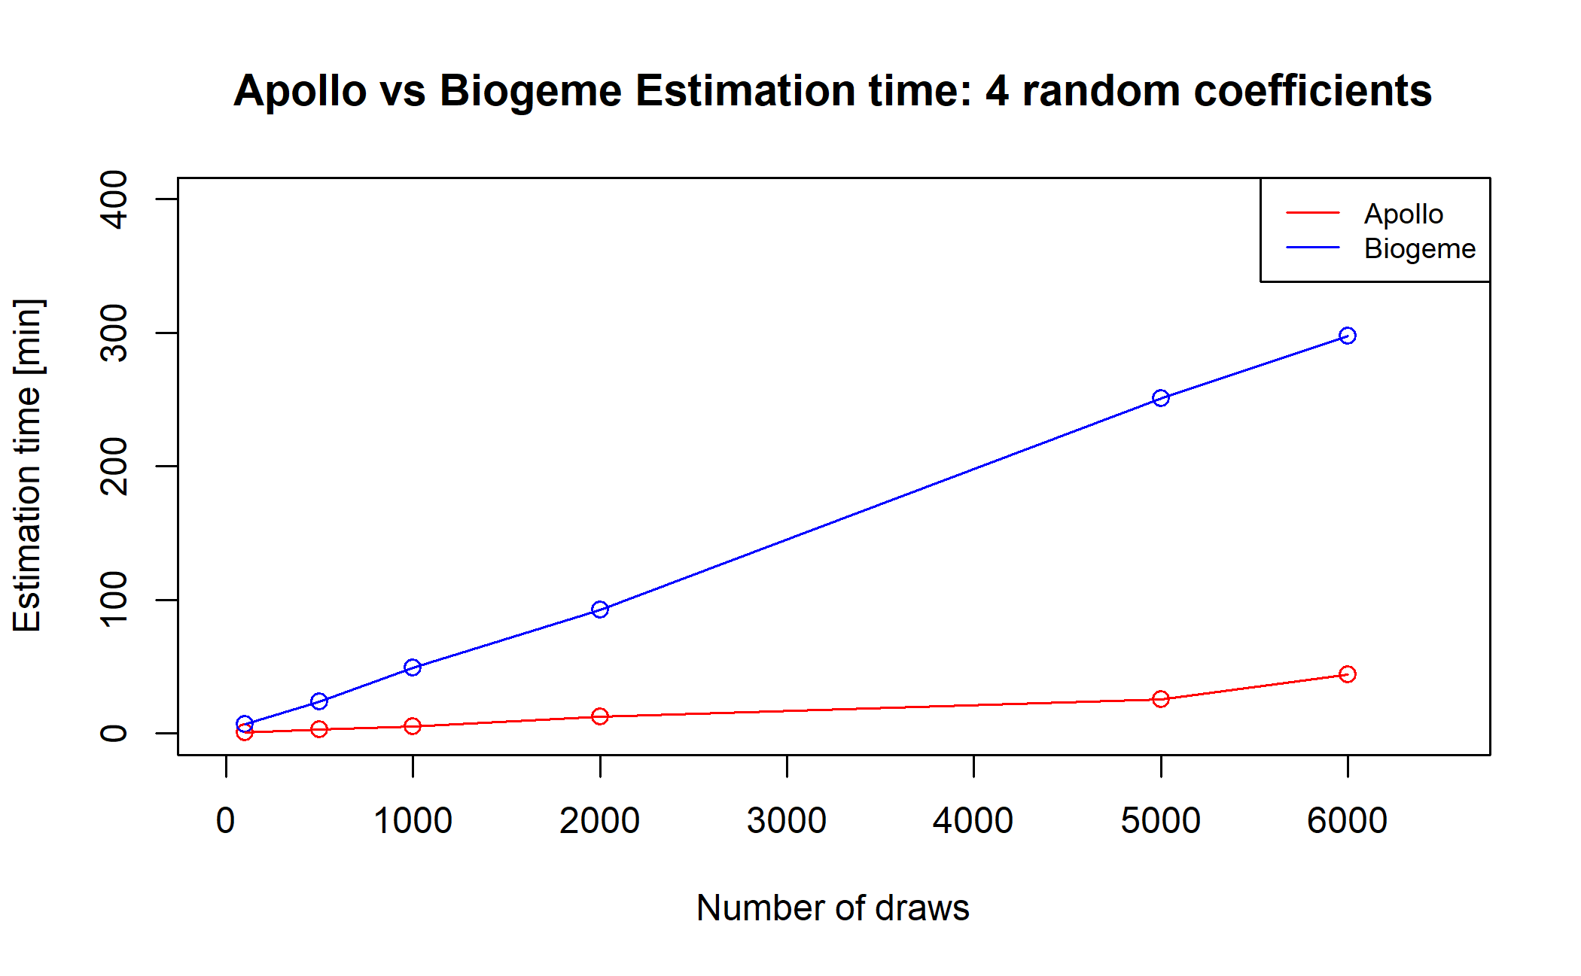
Draws Plot

Slide 19
Problems encountered
Error in Apollo: “Model diagnosis: False convergence”
⇨ change from BGW to BFGS

Slide 20
CPU / RAM usage

Slide 21
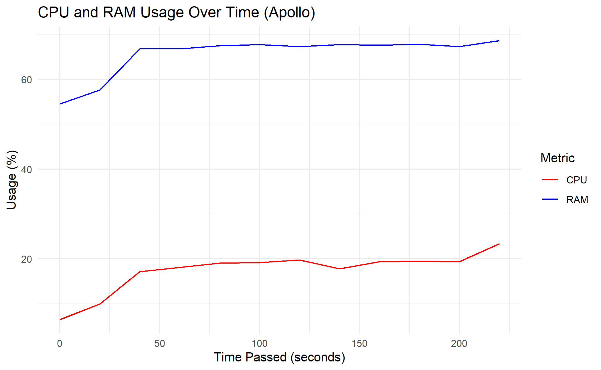
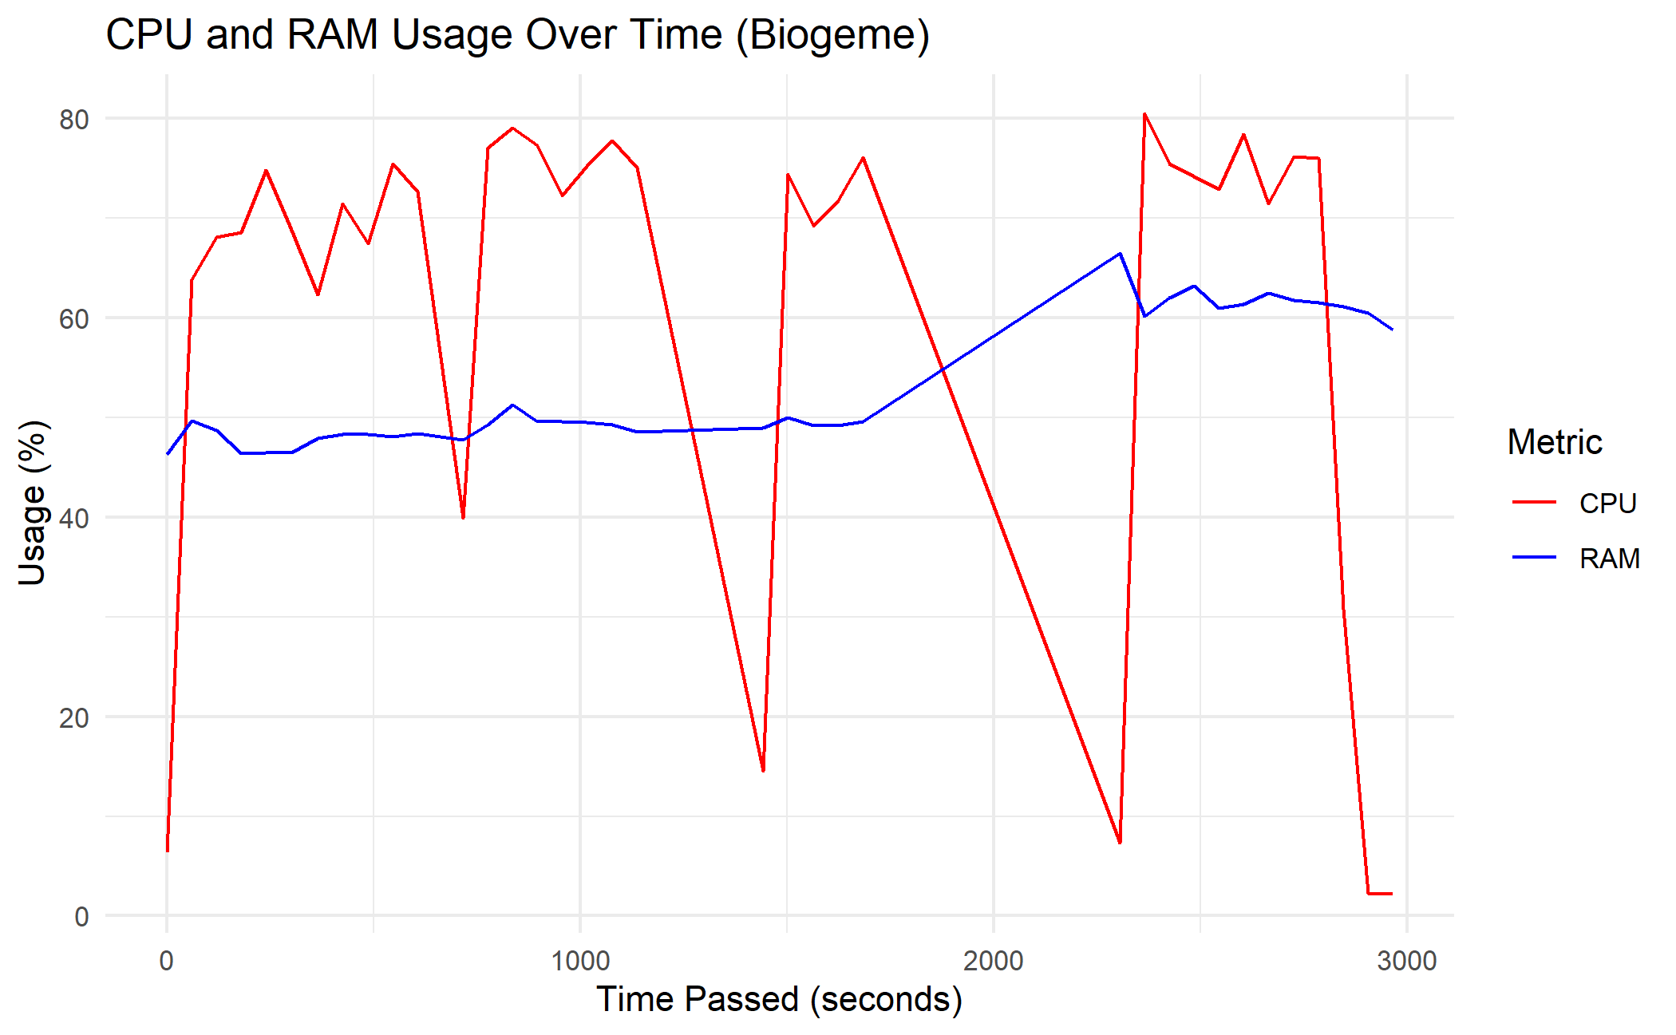
MMNL Preference Space

Slide 22
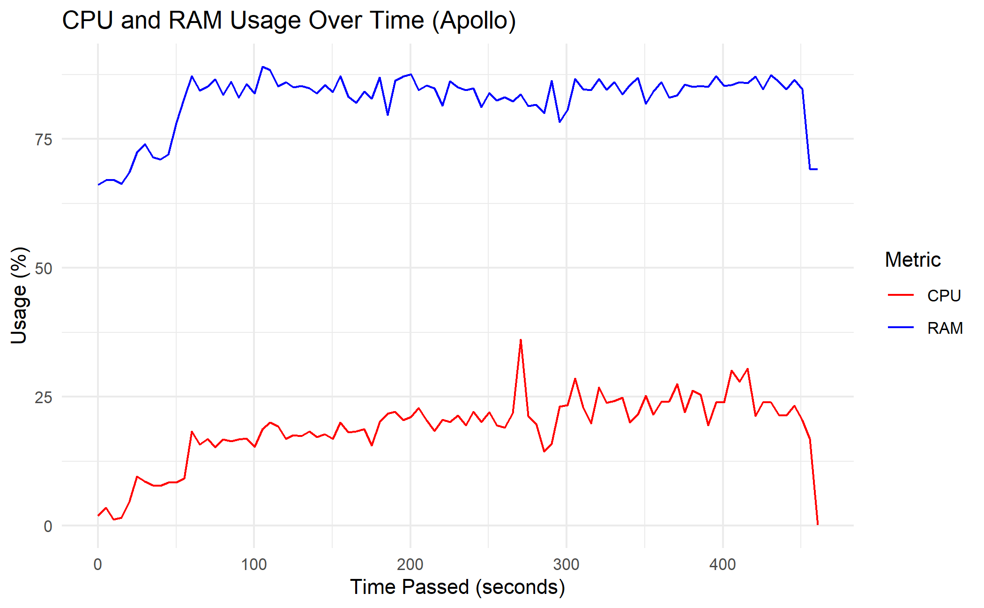
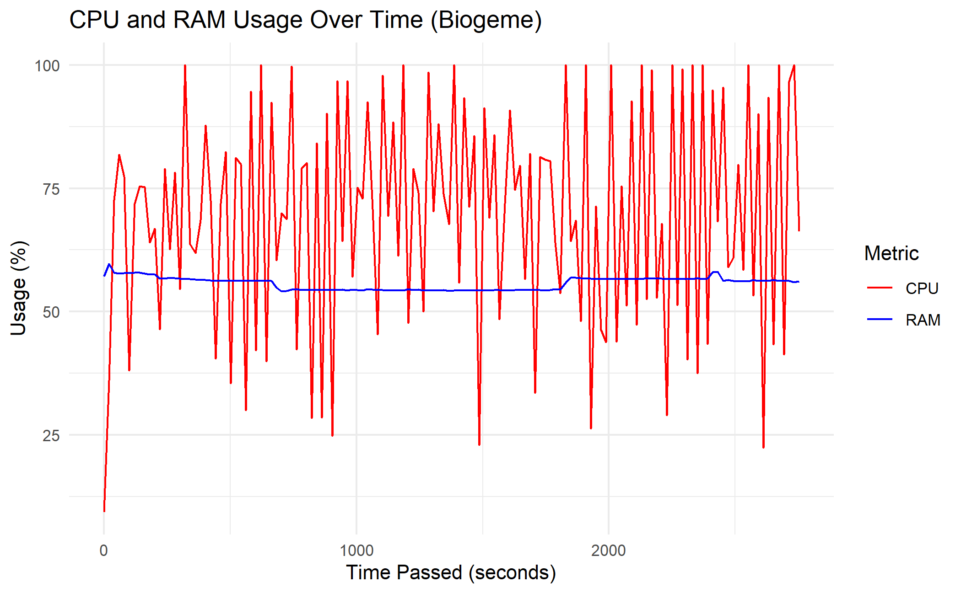
Swissmetro 2 (1000 draws)

Slide 23
Thank you for listening !

Slide 24
References
Hess, S. & Palma, D. (2019), Apollo: a flexible, powerful and customisable freeware package for choice model estimation and application, Journal of Choice Modelling
Michel Bierlaire (2023), A Short introduction to Biogeme
Michel Bierlaire (2023), École Polytechnique Fédérale de Lausanne, Biogeme Sphinx Documentation [https://biogeme.epfl.ch/sphinx/]
Axhausen, K. W. , Bierlaire, M. , & Abay, G. (2001), The acceptance of modal innovation, The case of Swissmetro

